Slide 1
All About Me
By Muneeb

Slide 2
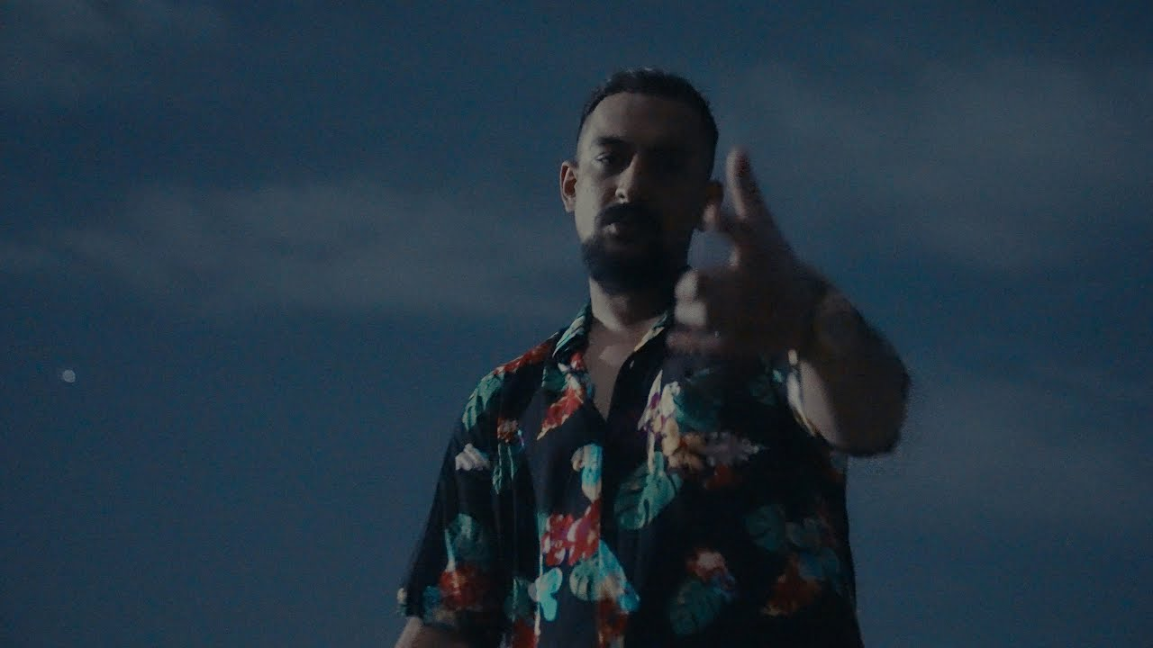
Introduction
My name is Muhammad Muneeb Lone
Born and raised in Rawalpindi
No specific favorite color
Image from Faris Shafi’s “Introduction”

Slide 3
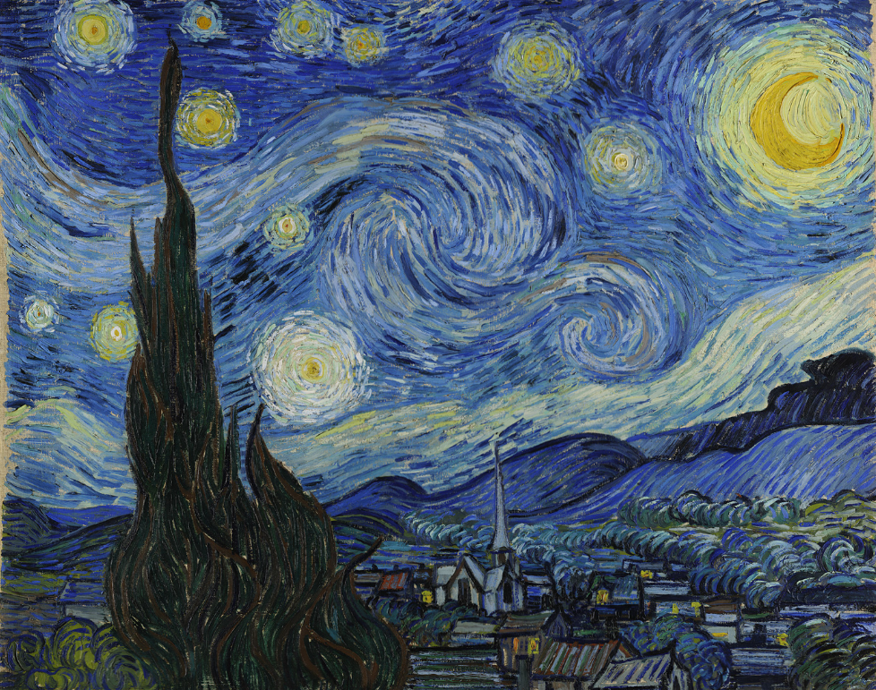
Birth
Born on 29th July 2004
Vincent Van Gogh died this day
Mussolini was born
Vincent Van Gogh’s Starry Nights

Slide 4
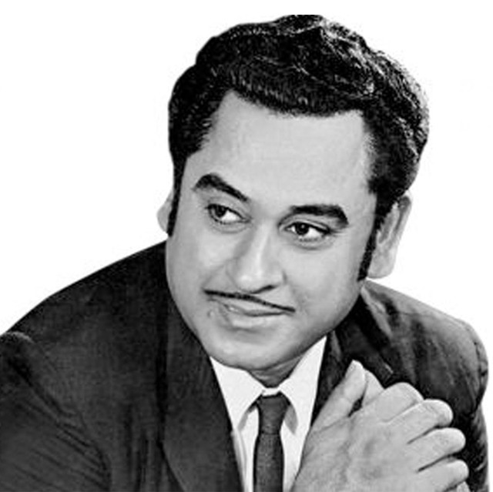
Music
My favorite type of music is Classic Bollywood
Favorite artist is Kishore Kumaar
My favorite song is Yeh Raatein , Yeh Mausam
Portrait Of Kishore Kumar on Spotify

Slide 5

Food
My favorite place Burger Co. in F6 Beverly Centre
I love their Smash Burger and Onion Rings
An Oreo Milkshake is a must in my order
Banner by The Burger Co.

